Slide 1
Artful Intersections
Bloomberg Philanthropies
Lancaster Public Art
SoWe Neighborhood
Tenfold
(formerly Lancaster Housing Opportunity Partnership and Tabor)

Slide 2
About the Grant Funding
Bloomberg Philanthropies invests in 510 cities and 129 countries around the world to ensure better, longer lives for the greatest number of people. The organization focuses on five key areas for creating lasting change: Arts, Education, Environment, Government Innovation, and Public Health.
About Asphalt Art
“Every project is unique, and every city will have its own approach — that’s part of what makes this work so dynamic. But we believe that by sharing lessons we learned, … we can give more city leaders the tools and inspiration to create brighter, safer, more welcoming streets for residents and visitors alike.” – Michael Bloomberg
Bloomberg Philanthropies has found that community-based street murals can have positive effects on safety and neighborhood development. This project will measure how it impacts those factors in the City of Lancaster at this site in the SoWe Neighborhood

Slide 3
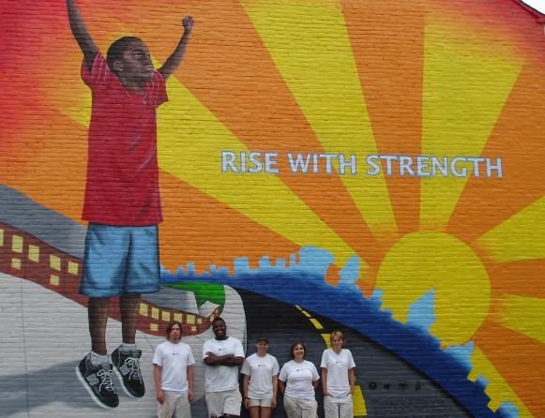
When people think about murals in Lancaster …

Slide 4
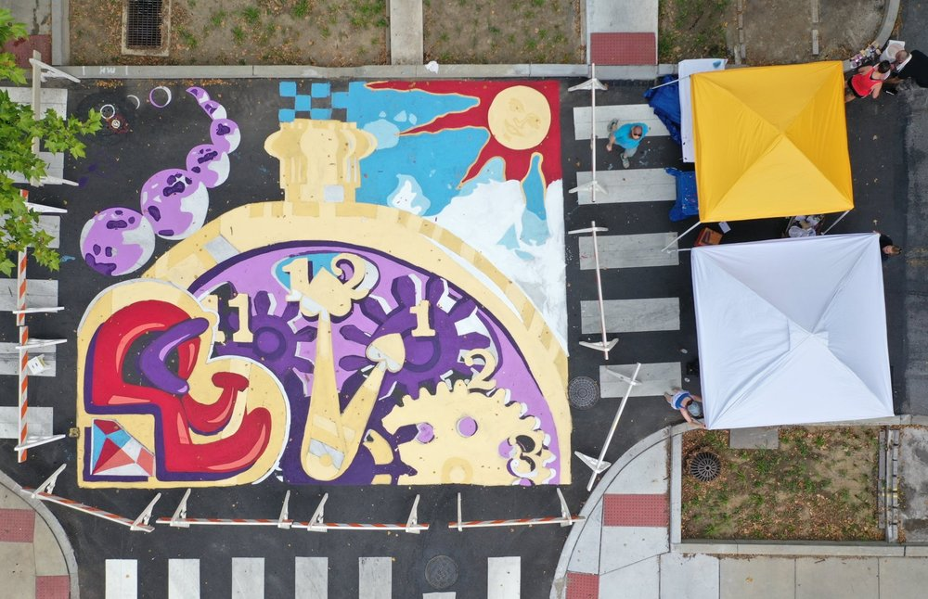
Crystal and First Streets, Lancaster City - 2019

Slide 5
What is unique about this type of mural for the 5-point intersection at W. Vine, S. Mulberry and W. Strawberry Streets?
Joint effort is being promoted by Lancaster Public Art , the SoWe neighborhood and the Department of Public Works
Temporary installation lasting 6-9 months
Intent is to create a traffic calming effect
Opportunity for improvements to the street layout at this intersection, not only to augment pedestrian and bike safety, but also to allow for better usage of this public space.
By generating art-oriented activities with the site neighbors, the City can learn how the community wants to use the space.

Slide 7
Encourage community participation to generate interest and input around reimagining the site.
Two mini projects (at least):
Tonight, June 3rd - Interactive design session and brainstorming, including:
drawing, sketching, concepts, ideas, subject themes, patterns and colors
(2) Saturday, June 26th - St. Joseph School parking lot from 10:00 am – noon
Lines will be temporarily taped on the street for the community to envision the site plan.
Use the fence along the former St. Joe’s school property to post ideas and for comments.
Use the center pocket park for discussion and sketching
(3) Social Media postings on SoWe website, Newsletter and Facebook page

Slide 8
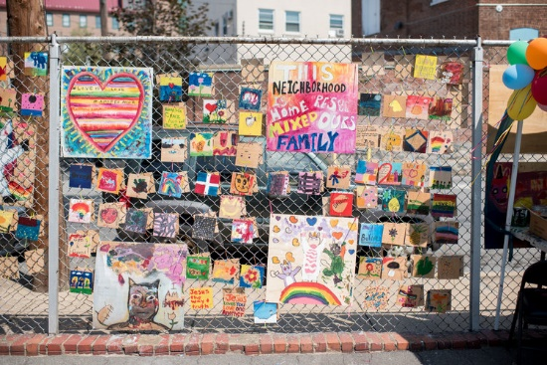

Slide 9
What to think about?
Simple designs that will not distract drivers
Images that can be viewed from all angles
Color combinations that are “calming”
Flowers, fruits, vegetables, herbs, plants
Images from the neighborhood
Cultural symbols
Inspirational words or ideas
[See handout for more suggested ideas!]

Slide 10
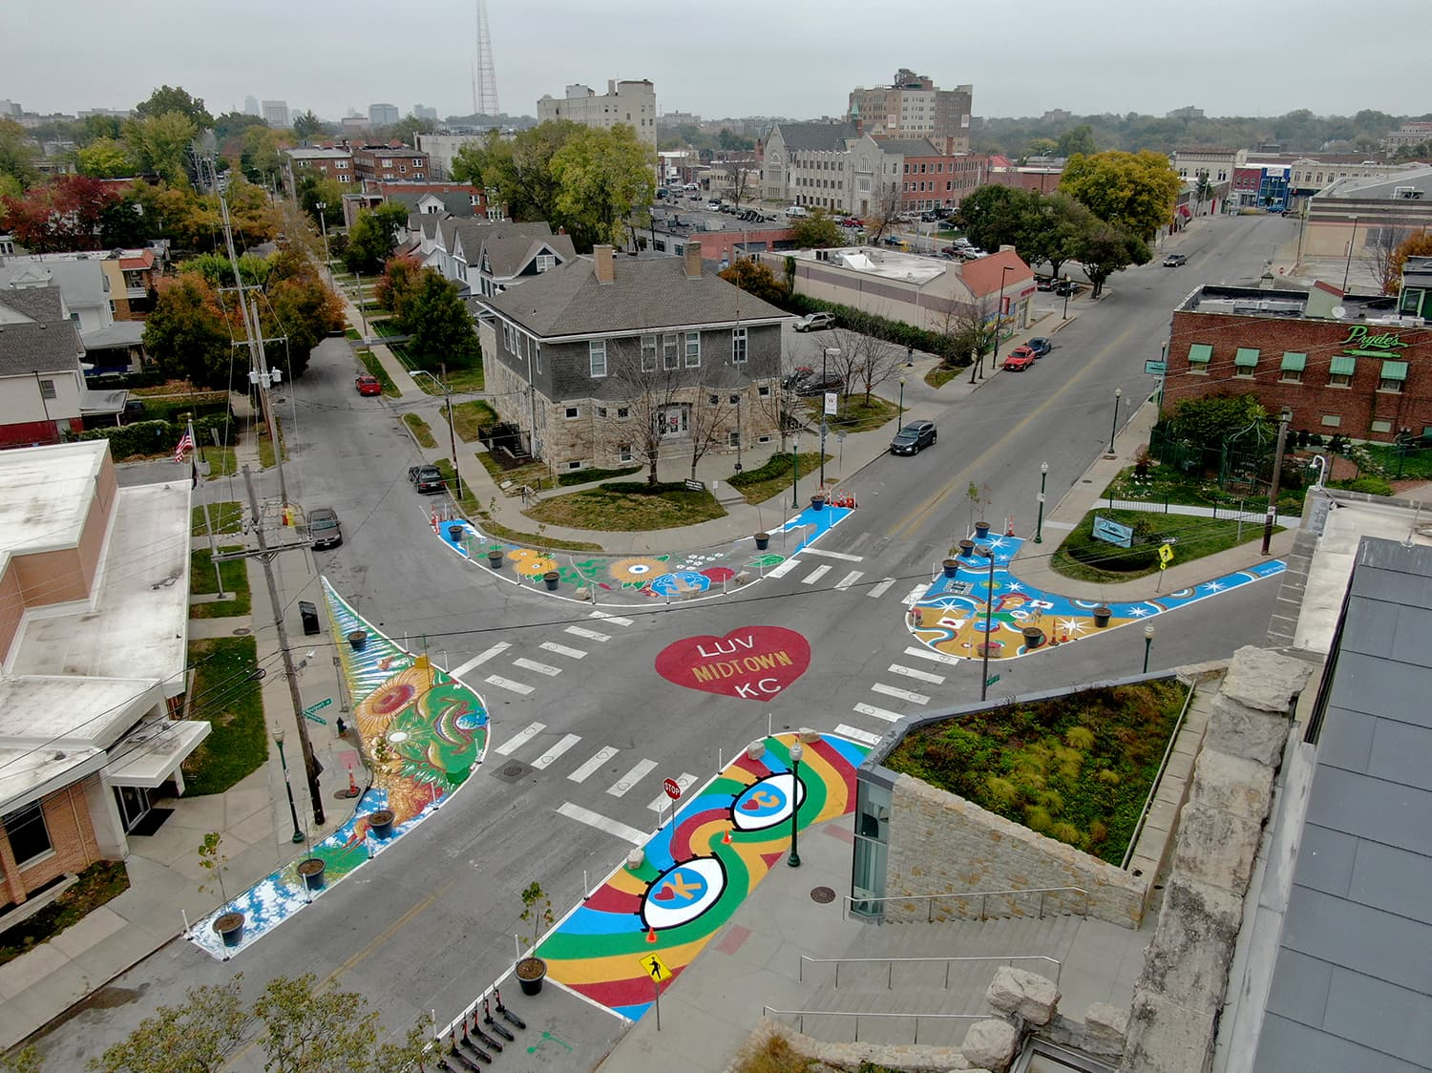

Slide 11
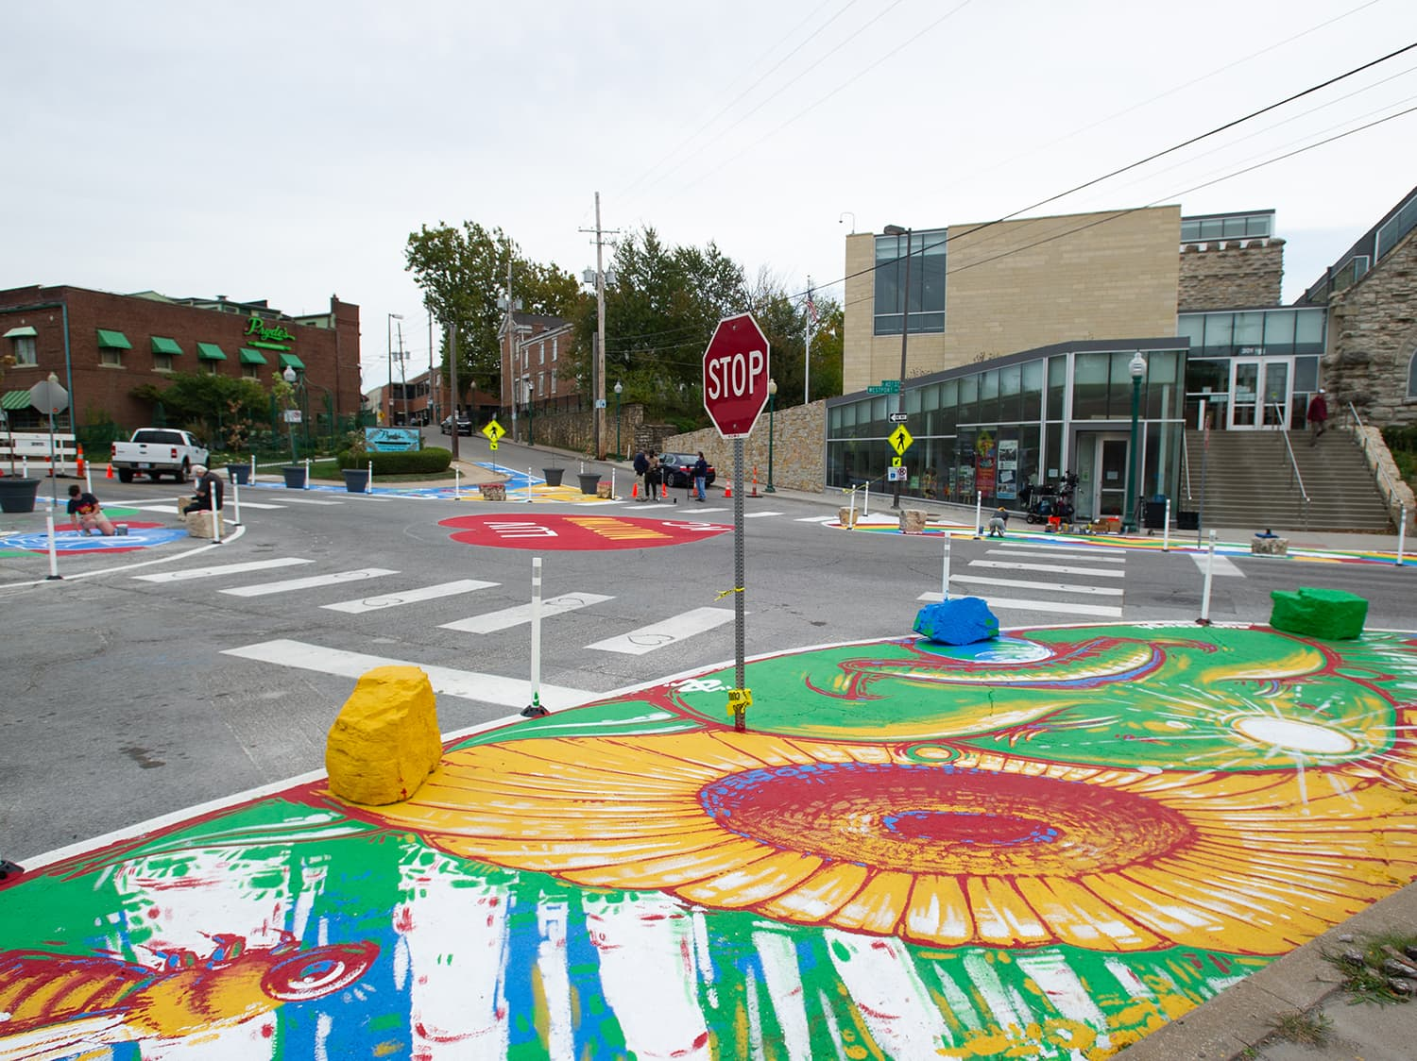

Slide 12
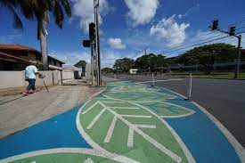
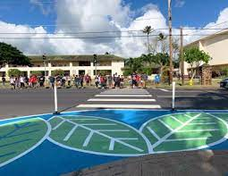

Slide 13
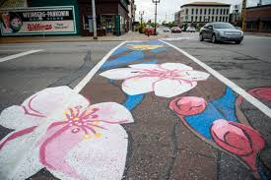

Slide 14
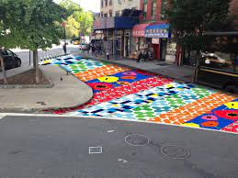

Slide 15
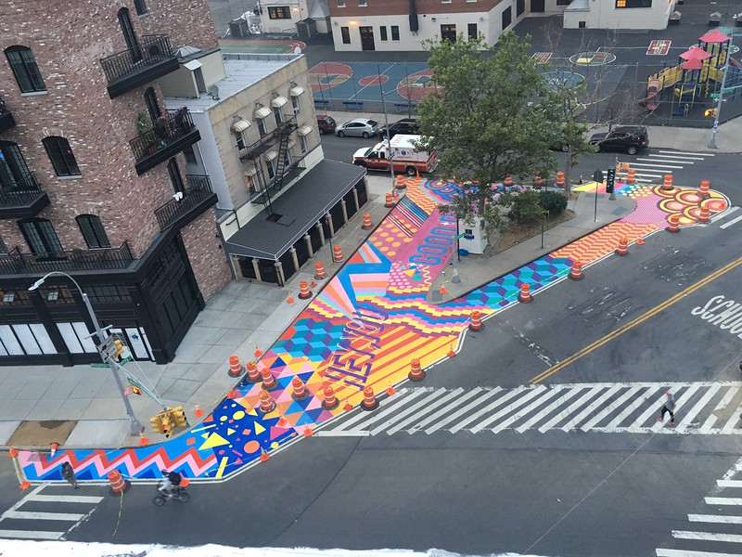

Slide 16
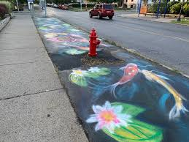

Slide 17
What to avoid?
Distracting patterns or complex images
Too many colors
Designs in crosswalks
Design throughout the intersection

Slide 18
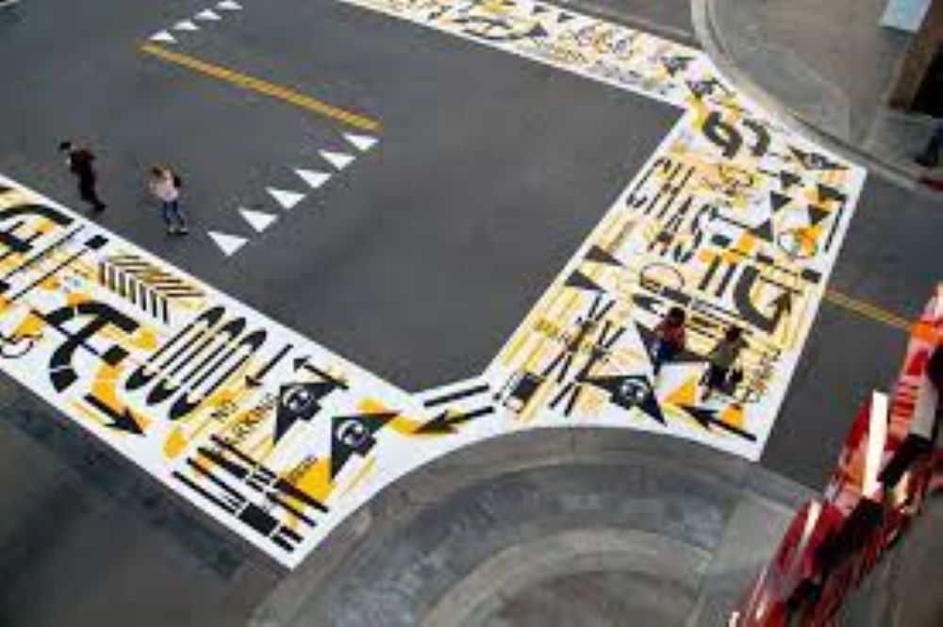

Slide 19
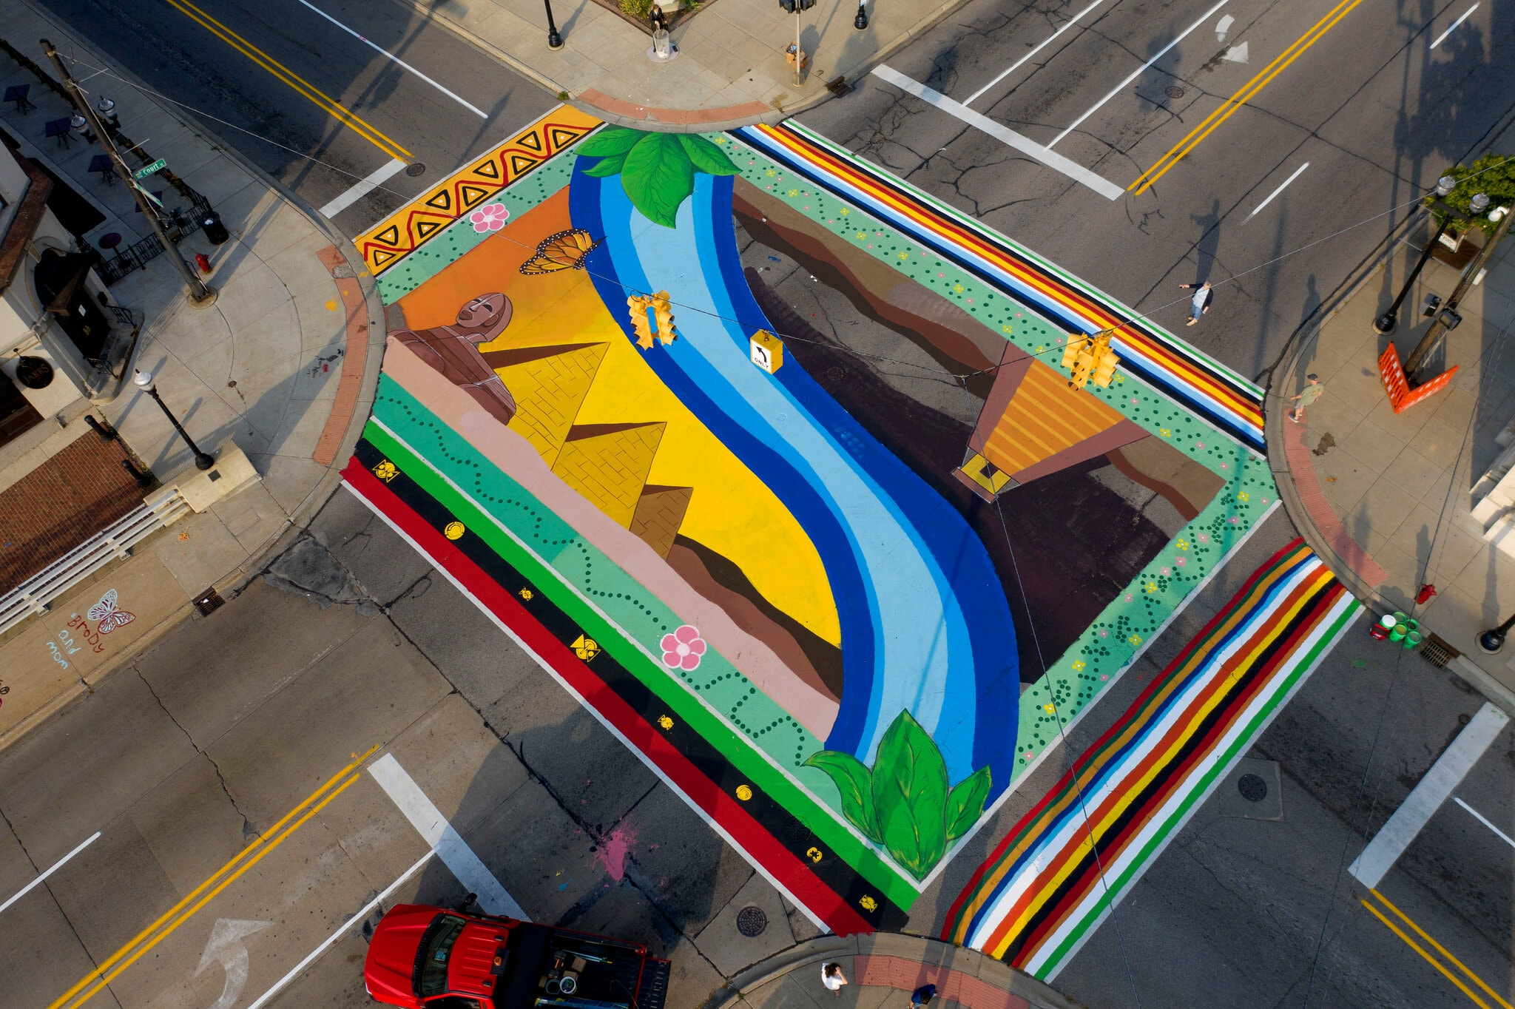

Slide 20
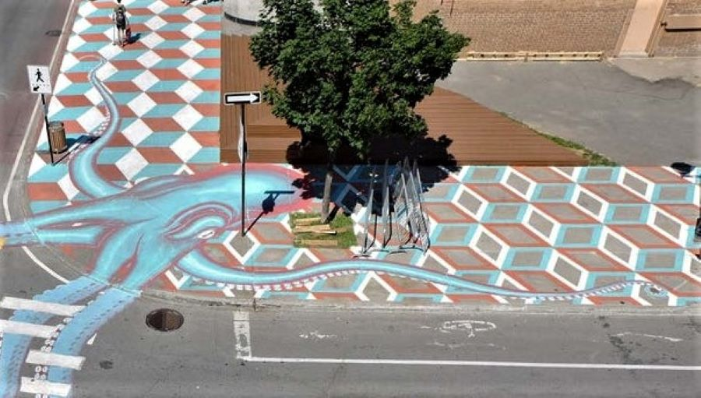

Slide 21
Proposed Schedule
May 20 – Artist is given notice to proceed.
June 7 – Project Team Meeting to share engagement plan and dates for participatory projects
June – Artists will engage community with mini participatory projects
June 30 – July 4 – Present concept designs to project team based on findings
July 15 – Final mural design
July 16 – July 31 – Public comment through Engage Lancaster
August 2 – Installation plan due to project team
September 11 – Project installation (Rain date is September 18)

Slide 22
Artist/s will document and post on social media what they are learning from the community through the mini-projects, surveys and other interactions.
Contacts:
Artist Team: Fern Dannis fern.dannis@gmail.com
Lancaster Public Art: Yarlyn Rosario Manager, Public Art Community Engagement Yrosario@cityoflancasterpa.org
SoWe Neighborhood: Jake Thorsen jthorsen@lhop.org
Engage Lancaster: https://engage.cityoflancasterpa.com/en/projects/artful-intersections-cabbage-hill

